Slide 1
In Search of an Understandable Consensus Algorithm. USENIX ATC'14
Haitong Li, Wenjing Fan
Notes:
Hello everyone, My name is Wenjing, this is Haitong. today, we will talk about “In search of an understandable consensus algorithm”

Slide 2
Motivation
Aim for: consistent and fault tolerant distributed system
Consensus algorithm: agreement on shared state
Notes:
For distributed system, we always want to build a consistent and fault-tolerant system. Consensus algorithm plays an important role in a distributed system. It makes multiple servers in a cluster get agreement on shared state, even if the minority of servers fail.

Slide 3
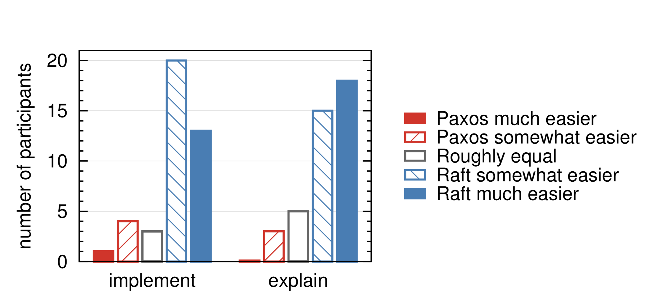
Raft: Designing for Understandability
Separate the process
Leader election
Log replication
safety
Reduce state space
Notes:
Last class, we learn about Paxos, today, we will introduce another consensus algorithm, it’s Raft.
we know Paxos has dominated the discussion of consensus algorithms many years, most implementations of consensus are based on Paxos or influenced by it. But Paxos is quite difficult to understand, for most of people. So Raft is designed, for understandability. It separates the processes of leader election, log replication, and safety and reduces state space, for example it reduces the ways servers become inconsistent. We will discuss its design in details later. In short, the author conducted a user study in two universities, in this graph, blue column means Raft much easier, it shows most students support that Raft is much easier than Paxos. Anyway, let’s go ahead and see if the conclusion is true.

Slide 4
Replicated State Machines

Slide 5

Replicated State Machines
commands
consensus module
logs
state machines
clients
Notes:
let’s look at replicated state machines first. Because consensus algorithms are typically proposed based on replicated state machines.
State machine refers to a deterministic server. The small green circle in this graph. Then we replicated server, usually using a replicated log. When clients send commands, the consensus module on a server, receives commands and adds them to its log. Each log contains the same commands in the same order, so each state machine processes the same sequence of commands. Since the state machines are deterministic, the sequence of outputs in each state machine are the same. As a result, the servers appear to form a single, highly reliable state machine.
How to keep the replicated log consistent and make replicated state machine be fault-tolerant, it’s consensus algorithm’s job.

Slide 6
Consensus algorithms properties
Ensure safety (network delays, partitions, packet loss, duplication, and reordering)
High availability
Do not depend on timing to ensure the consistency
Command completes quickly
Notes:
. Notice that, in a practical system, consensus algorithms should have these properties. Firstly, they ensure safe under conditions like network delays, partitions, and packet loss, duplication, and reordering.
. Secondly, high availability, they should be fully functional as long as majority of servers are fully functional.
. Thirdly, They do not depend on timing to ensure the consistency of the logs: faulty clocks and extreme message delays can cause problems we can’t expect.
. The last one, command completes quickly, a command can complete as long as majority
response to it.
Now, Haitong will introduce Raft in detail.

Slide 7
The Raft Consensus Algorithm

Slide 8
Raft Overview
Leader election: a leader for each cluster
Log replication: replicate across the cluster
Safety (state machine safety): only one log entry will be applied at each index
Notes:
Raft breaks the consensus problem into three relatively independent subproblems.
Leader election: for each raft cluster, which is formed by a few servers, there must be a leader selected to manage the replicated logs
Log replication: the leader must accept the requests from the clients and replicate them as log entries on other servers in the cluster
Safety: if one of the servers has applied a log entry at some index to its state machine, no other server will apply a different log entry to the same index

Slide 9
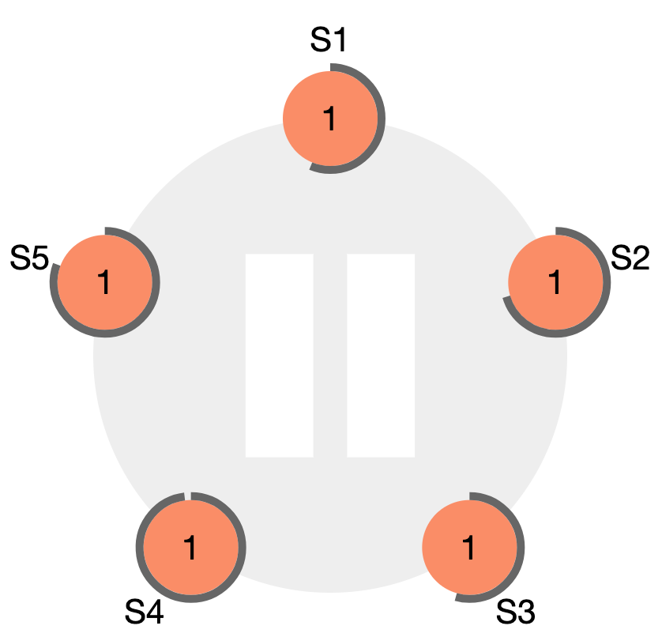
Raft Basics - Structure
Servers
Randomized
Election timeout
Cluster
Term number
Notes:
This is a typical Raft cluster with five servers, which is able to tolerate two failures because only a majority of the cluster need to be working to ensure the operation
We can see that there is a term number on each server. Raft divides time into terms of arbitrary length, and each term starts with an election. If a server wins and becomes a leader, it will be responsible for the rest of the term unless it fails.
The randomized election timeout is used to facilitate the leader election. It is basically a timer at each server with random length. For example, if the leader has crashed, the server that first times out will become a candidate for election

Slide 10
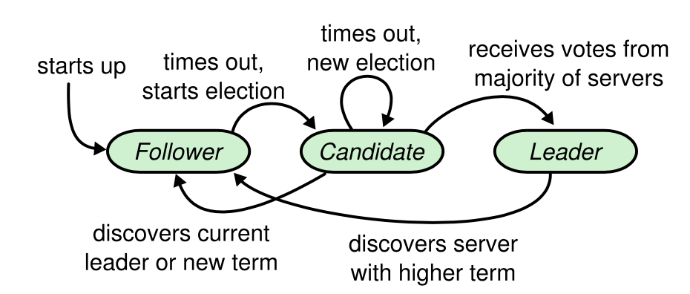
Raft Basics - States
Split vote
Split vote
Notes:
Each server will be in one of the states while it’s working. All servers will start in the follower state. The followers only respond to requests from other servers. When a follower receives no communication and it times out, it becomes a candidate and starts an election. If it receives a majority of votes, it becomes the leader of a new term. There may be multiple candidates if they all time out at the same time, and it can lead to a split vote in which no leader is selected. (later)
If a leader failed for several terms and restarts, it will discover that the other servers are in a higher term, and it will revert itself to follower state

Slide 11
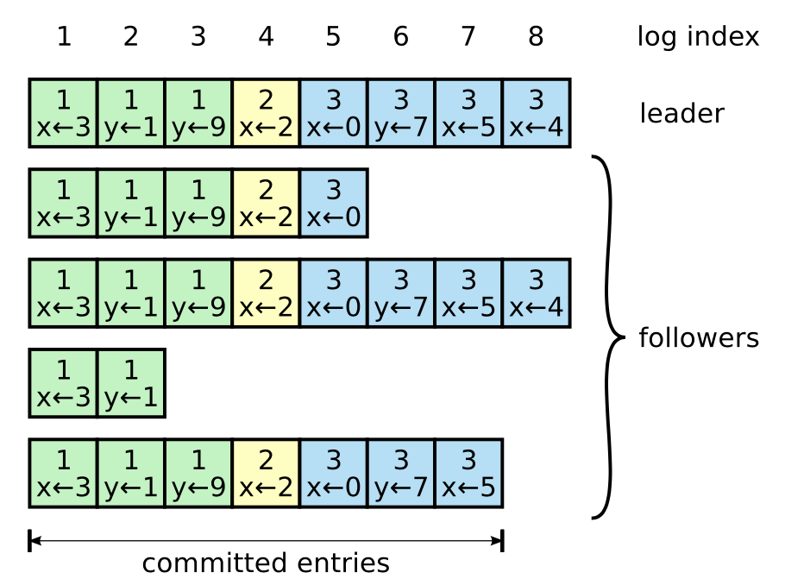
Raft Basics - Log
Notes:
Once a server is selected to become leader, it will start to receive the clients’ requests. The servers will append the request as a log entry to their logs before actually they execute it. This is how the logs of a typical five server cluster look like. Each log entry will be sequentially numbered by a log index, and it will contain the command as well as the term number it was added. Once a log entry has been replicated to a majority of the servers, it can be recognized as committed.

Slide 12
Raft Basics - Communication
Remote procedure calls (RPCs):
RequestVote (candidate): gather votes for an election
Term number
AppendEntries (leader): replicate log entries
Term number + last index + the new entry
Notes:
Servers in Raft uses remote procedure calls to communicate. The RPCs allow a program to request a service on another computer without knowing the network details. There are two RPCs used in Raft. RequestVote is sent by a candidate to ask for votes from other servers. AppendEntries is used by a leader to replicate log entries on the followers. Both RPCs will include the current term number. And AppendEntries RPCs will also contain the index of the last entry in the leader’s log.

Slide 13
Leader Election

Slide 14
Leader Election - Normal Operation
Heartbeat: AppendEntries RPC without log entry
Notes:
Raft uses a heartbeat mechanism to manage leader election. When a server becomes leader, it starts to send periodic heartbeats, which are AppendEntries RPCs with no log entry, to the followers. If a follower doesn’t receive any heartbeat and it reaches the election timeout, it will assume that there is no leader and start an election.

Slide 15
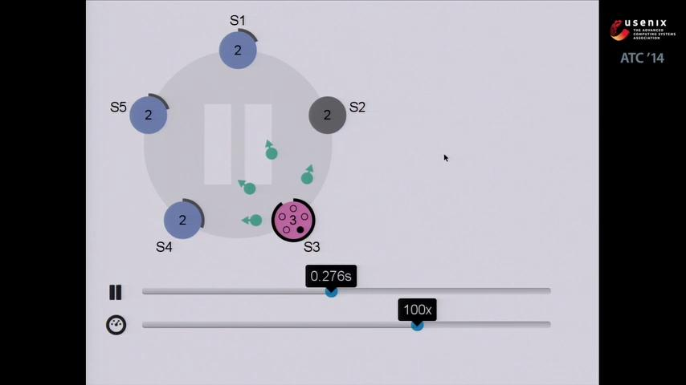
Notes:
I’ll walk through the leader election process with a visualization provided by the developers of Raft.
Here s2 was the leader for term 2, and it has failed now, and s3 is about to timeout. When it times out, it enters the candidate state and increments itself to term 3. It will first vote for itself, which is represented by the black dot on s3, and then send out RequestVote RPCs and if a majority of the servers vote for it, it will become the leader for term 3. The request will contain a message saying that s3 is now in term 3. If the other servers agree to vote for s3, they will move into term 3 and respond positively to s3. Now s3 is the leader and it starts to send out heartbeats and receive client’s requests.

Slide 16
Leader Election - Multiple Candidates
(Term number)
Waiting for votes from other servers...
Leader >= Candidate
Candidate 1
Candidate 1
Follower
Heartbeats
Candidate 2
Leader
Got a majority of votes
Notes:
It’s possible for a candidate to receive heartbeats from another server as a leader while it’s waiting for votes. It will compare the term numbers and decide what to do next. If the leader’s term is smaller than the candidate’s, which will happen when the leader failed for some terms and restarts, the candidate will reject the RPC and stays in candidate state. If the leader’s term is the same as the candidate’s, it means that they were the candidates for the same term, and the leader here won the election first and became the leader. And the candidate will revert to follower state. If the leader’s term is greater than the candidate’s, it happens when the candidate didn’t work for a period and is out-of-date. It will also return to follower state and move into the leader’s term.

Slide 17
Leader Election - Split Vote
Randomized election timeout: randomly picked from a fixed interval (150 - 300 ms)
Notes:
A special case in leader election is a split vote. It is the situation when multiple servers timeout at the same time, become candidates and no candidate gets the majority of votes. Raft uses randomized election timeouts, which generally ranges from 150 - 300 ms, to deal with the problem. The randomized timeouts largely reduce the chance for multiple servers to time out at the same point. At the start of each election, the candidates will restart their timeouts so that if there is a split vote, it is unlikely that there will be another split vote in the next round of election.
Next I’ll show the actual process of how Raft deals with split vote with the visualization.

Slide 18
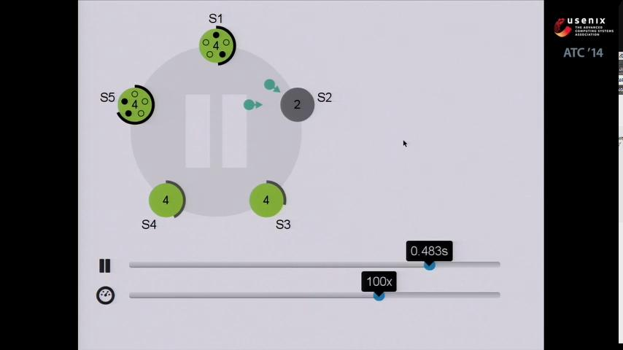
Notes:
S2 was our leader for term 2, and it has failed. Now we need to elect a leader for the next term of operation. We can see that s1 and s5 are about to timeout at the same time. Once they timeout, they will both become candidates for the election. They time out, incremented their term number to term 3, and voted for themselves. Then they are going to send out RequestVote RPCs to ask for votes from the rest of the cluster. Unfortunately, they each only gets one vote from the other servers, and since they need 3 votes out 5 to be a leader, there is no winner for this round of election. They will keep trying to reach s2, but s2 is not in service and cannot respond to their requests. We need to wait for the next server to time out and start another round of election. Since the candidates restarted their election timeouts when they started the election, it is likely that there will be another server times out before them. In this case, we can see that s3 is going to time out before s1 and s5. Once it times out, it will move to term 5, vote for itself, and asks for votes. When s1 and s5 get the requests, they will notice that s3 is in a higher term, so they will revert to the follower state. If a majority of the cluster agree to vote for s3, it will become the leader and start sending heartbeats.

Slide 19
Log Replication

Slide 20
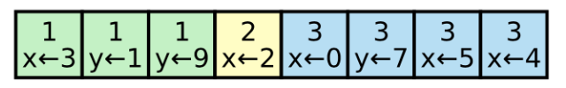

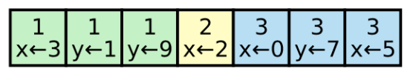
Log Replication Process
AppendEntries
Server 1
X <- 4
Client
Leader
Append the entry to its log
Server 2
Server 2
AppendEntries
Notes:
Now i’ll walk through the log replication process. Everytime a client sends a request to the leader, the message includes a command that needed to be applied to the replicated state machines. Here the client sends a command that sets x to 4, and the leader will first append the log entry to its log. It will then send AppendEntries RPCs to the followers to append the entry to their logs. If a server is operating, it receives the AppendEntries request, and appends the entry to its log. Some of the servers may be offline for the current term. If it’s the case, the leader will retry the AE request until the follower is up and responds. Eventually, the log entry will be replicated to all servers.
However, if server 2 never restarts for the entire term. Things will get more complicated.

Slide 21
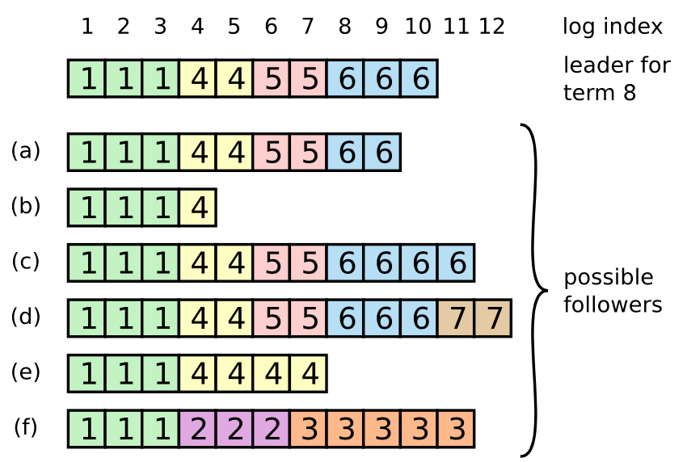
Log Replication - Repairing Inconsistencies
Missing
Extraneous
Both
Notes:
There will be inconsistencies if there is a problem like a network partition or a temporary failure of a server. A server may be missing some of the committed log entries if it’s down when they were committed. If we look at log b, we can infer that the server failed after the log entry at index 4 was added to its log in term 4. There can also be some extraneous log entries on some server. A situation like log d is probably because server d was the leader for term 7. It received 2 requests and added log entries at index 11 and 12 and then crashed. The two kinds of inconsistencies can happen together depending on the situation.

Slide 22
Log Replication - Repairing Inconsistencies
Followers duplicate the leader’s log
AppendEntries RPC consistency check (including Heartbeats): Includes the index and term of the last committed entry
Success: the entries match
Failure: not found in follower’s log
Notes:
Raft deals with the inconsistencies by forcing the followers to duplicate its own log. In Raft, every AE RPC, including the regular heartbeats, performs a consistency check. As I mentioned before, every AppendEntries request contains the index and the term number of the last committed log entry in the leader’s log. If the request is successful, it means that the last entry on the follower’s side matched with that on the leader. If they didn’t match, the follower will reject the AppendEntries request.

Slide 23

Log Replication - Missing Entries
AppendEntries consistency check
Index decremented
Rejected
Retry AppendEntries
Success
Follower does not have the entry
Entry matched
Leader
Follower
Match Index
Notes:
Raft uses similar approaches to handle the inconsistencies in logs. I will first talk about how it deals with the missing entries. We know that AppendEntries consistency checks are used to check if the leader’s log matches with a follower’s log. If the request is rejected, it means that the follower does not have any log entry on the given index and term included in the request. In this case, the leader will decrement the index in the AE request, and try again. It will keep decrementing the index and retry until it finds a match index or reaches the beginning of the log. Here since the leader has found a match index at 9, it can start to replicate any log entry in its log after the point to the follower.

Slide 24
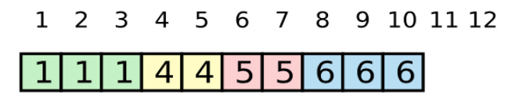

Log Replication - Extraneous Entries
Leader will remove any extraneous entries of a follower
Leader
Match Index
Follower
Notes:
We know that the leader will force the followers to duplicate its log if there is any inconsistency. In the case where there are some extraneous entries in the follower’s log, the same consistency check will be performed until the match index is found. In this particular case, the logs matched at index 10. Once the leader knows that there is a match index, it will remove any extraneous log entries in the followers log. And their logs will be exactly the same.

Slide 25
Safety
Notes:
Next, we talk about the safety of Raft.

Slide 26
Safety - Election Restriction
1
2
S1
3
S1
1
2
Up-to-date:
Later term
Longer log
1
2
S2
3
S2
1
2
1
2
S3
3
S3
1
2
1
2
S4
3
S4
1
1
3
1
S5
S5
time out
New leader must include committed log.
Otherwise refused by voter.
Notes:
Without election restriction, let’s see what will happen?
At first, s5 is unavailable, s1(S one) is the leader and after a series of processes, s1 commits log entry in term 2. Then s5 becomes available, and can be elected as the leader in term 3 and overwrite these entry with new one. But the state machine has a different output in term 2.
Raft has a simple method to avoid this problem. It guarantees new leader must include committed log from previous terms. (图中) in this situation, s5 can’t be elected as a leader because it doesn’t include log 2. This restriction means log entries only flow in one direction, from leaders to followers, and leaders never overwrite existing entries in their logs.
How to implement this restriction?
In raft, (when a candidate sends requestVote RPC) （remote procedure calls）, the RPC includes information about the candidate’s log, and the voter denies its vote if its own log is more up-to-date than the candidate’s log.
Then “How to decide Which log is more up-to-date”?
If the logs have last entries with different terms, then the log with the later term is more up-to-date. If the logs end with the same term, then which log is longer is more up-to-date.
(右边的图)for example, S1 replicate log and get majority vote, and term 2 log is commited. Then S1 crashes, now S5 times out and become a candidate, but according to the rule, S5 does not include committed log, (the yellow term 2 log) so S2, S3 compare S5’s log to themselves, and deny their vote because their own log is more up-to-date. Next S3 times out and it can receive majority votes and become a new leader.

Slide 27
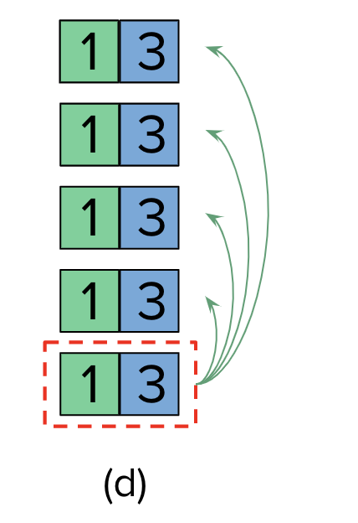

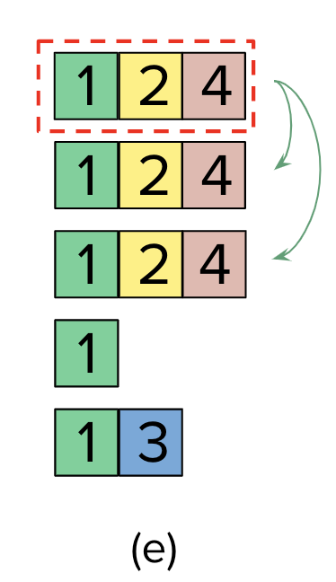

Safety - Committing Entries from Previous Terms
S1
1
2
1
2
1
2
4
S2
1
2
1
2
1
2
S3
1
1
1
2
S4
1
1
1
1
1
3
1
3
S5
(a)
(b)
(c)
Notes:
Next point is, when to commit entries from previous terms
Let’s imagine a situation. a leader knows that an entry from its current term should be committed once that entry is stored on majority of the servers. But if a leader crashes before committing an entry, future leaders will attempt to finish replicating the entry. However, a leader cannot conclude that an entry from a previous term is committed even if it is stored on a majority of servers.
(leader记录commit之前crash, 之后的term leader 不能根据多数派提交前任leader留下的log )。
图：why a leader cannot determine if log entry was committed, by using log entries from older terms. Let’s see this example:
(a) at first, S1 is leader and partially replicates the log entry, term 2’s log. now the log status is uncommitted..
(b) now S1 crashes; S5 is elected as new leader, with votes from S3, S4, and itself, and accepts a different entry, in term 3.
(c) Now S5 crashes; S1 restarts, and again, is elected as the leader, and continues its replication. Now, the log entry from term 2 has been replicated on majority of the servers, but it is not committed yet.
Now, the question is, when s1 retake the leader in term 4, can term 2 log be committed because it was replicated with majority? The answer is no!
(d) We can see, if term 2’s log committed, now S1 crashes again, S5 is elected as the leader, it satisfies the election restriction. (it can get votes from S2, S3, and S4 because 3 is larger than 2) and overwrite the entry with its own entry from term 3. That will cause inconsistency. So it’s not the right time to commit term 2 log.
But if S1 doesn’t crash, when it can commit former leader’s log?
(e) We can see in picture (e), if S1 replicates an entry from its term 4 to the majority of the servers before crashing, now, it’s safe time to commit term 2’s log and term 4’s log. Because now, the majority of servers has received term 4’s log entry, so even if S1 crashes, S5 cannot win an election, because term 3 is smaller than term 4. that can avoid the problem in d.
So in raft, current term won’t commit log entries from older terms by counting majority. When it counts, current term log entries has majority, the log entries will be committed, including former term. It’s a conservative but safe way.

Slide 28
If Followers and Candidates Crashes...
RequestVote
Or
AppendEntries
Leader
Follower
Check & Avoid repeated responding behaviors
Notes:
Until now, we always focused on leader failures. Follower and candidate crashes are much simpler, they can be solved in the same way. (点)
If a follower or candidate crashes, apparently, it has no chance to become a leader, right? So consider its performance of receiving information. It will fail to receive all the requests from others. Then Raft will retry again and agin to send RequestVote and AppendEntries RPC (Remote procedure calls).
If the crashed server restarts, then RPC can complete successfully.
If this server complete an RPC and before responding, it crashed, the server will receive the same RPC after it restarts, Raft can distinguish RPC and avoid repeated behaviors.
（（For example, if a follower receives an AppendEntries request that includes log entries already present in its log, it will ignore those entries in the new request. ））
(如果发requestVote，follower投过票之后crash，那么leader不会再给他发request了)

Slide 29
Timing and availability
Raft requires: safety must not depend on timing.
Except: for availability
Broadcast Time << Election Timeout << MTBF
average time between failures for a single server
Notes:
We’ve mentioned before, Raft requires that, safety must not depend on timing. However, availability must depend on timing. For example, On the one hand, Raft needs a steady leader to work, but if the message broadcast takes longer than election timeout, candidates will start a new election again and again. On the other hand, If servers often crash, there is also not a steady leader.
So the system should satisfy the following timing requirement.
The broadcast time should be less than the election timeout so that leaders can reliably send the heartbeat messages required, to avoid followers starting elections;
The election timeout should be far less than MTBF so that the system makes steady progress. (MTBF refers to the average time between failures for a single server) When the leader crashes, the system will be unavailable for a while, until the election time-out.

Slide 30
Cluster Membership Changes

Slide 31
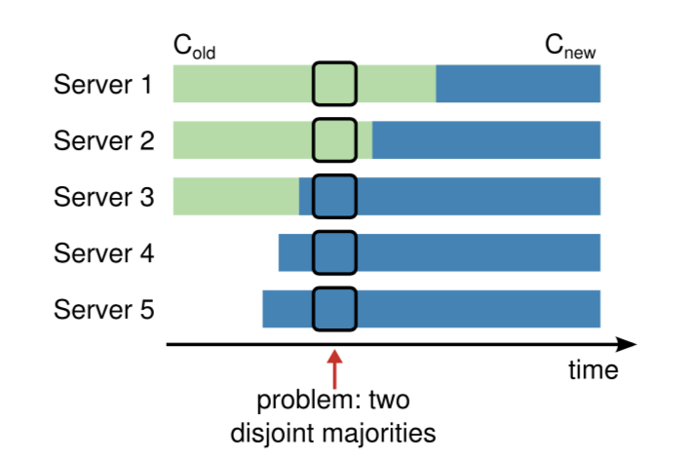
Cluster Membership Changes
Time t
If we switch directly from old to new configuration...
unsafe!
Notes:
until now we have assumed that the cluster configuration is fixed. But in practice, sometimes we need to change the cluster configuration. For example, we want to replace servers when they fail or add some new servers. But we don’t want to offine the cluster then update, because this will make the system unavailable for a long time.
In raft, it incorporates “automate configuration changes” into its algorithm.
First, let’s see what’s the problem if we switch directly from old to new configuration.
In this graph, the cluster has three servers at first, Now we add server 4 and server 5 to this cluster. The configuration need to be updated. Since every server may take different time to update the configuration. In this situation, Server 3 finish its update first, change from C_old to C_new, and Server 1 and 2 still under old configuration.
At time t, there will be 2 leaders elected at the same term. Because in old config, assume server 1 times out first, then it supposes there are 3 voters, so when it gets server 2’s vote, plus itself, server 1 is selected as the leader. At the same time, in new config, assume server 5 times out, then it supposes there are 5 voters, and gets votes from server 3,4,5. So server 5 is elected as the leader too.
So switching directly is unsafe because we can’t stand there are 2 leaders at the same time.

Slide 32
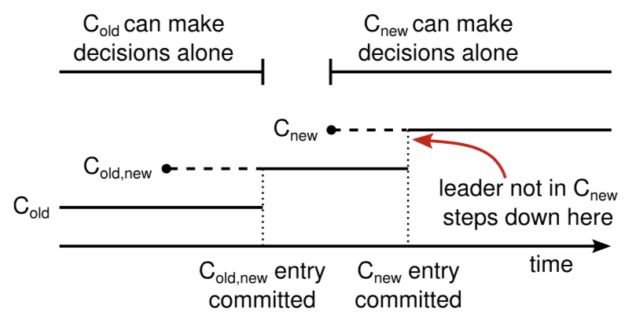
Cluster Membership Changes
cluster transitional configuration new configuration
(joint consensus)
Agreement (for elections and entry commitment) requires both the majority of C_{old} and the majority of C_{new}
Once a server adds the new config entry to its log, it uses that config for all future decisions
Notes:
In order to ensure safety, configuration changes must use a two-phase approach.
In Raft the cluster first switches to a transitional configuration, we call joint consensus; once the joint consensus has been committed, the system then transfers to the new configuration.
Let’s see the timeline for a configuration change. C-old means in old config,
C-old, new means in transitional config. And C-new means in new config.
There are 2 rules need to be noticed, first, Agreement (for elections and entry commitment) requires both the majority of C-old and the majority of C-new.
Second, Once a server adds the new config entry to its log, it uses that configuration for all future decisions.
Back to the timeline. When the leader receives the configuration change request, it stores the config in C-old, new and replicate config to other servers. Before C-old, new committed, C-old can make decision alone, only C-old can vote. but C-new cannot. Once majority of C-old and majority of C-new receive this entry, C-old, new is committed. Now C-old cannot make decisions alone anymore. When C-old, new committed, only server with C-old, new log can be elected as the leader. Now It is safe for the leader to create a log entry describing C-new and replicate it to the cluster. When C-new entry becomes majority, it can be committed. After C-new committed, servers not in the new configuration can be shut down . And we finish this update.
We can see, there is no time when Cold and Cnew can both make their own decisions, this approach avoids unsafe problem as we said before.

Slide 33
Conclusion
Notes:
So, give a conclusion.

Slide 34
Conclusion
Paxos: including two-phase protocol for consensus and a separate leader election
Raft: incorporating leader election directly into the first phase protocol for consensus
Less mechanism
Easier to understand
Notes:
Where is the improvement of Raft, compared with Paxos?
Paxos includes both a two-phase protocol for basic consensus and a separate mechanism for leader election. In contrast, Raft incorporates leader election directly into the consensus algorithm and uses it as the first phases of consensus. This results in less mechanism than in Paxos. In short, raft is a simpler algorithm and easier to understand for us.
That’s all.
(But paxos has better performance than raft, because raft is a simplified version. for example, in Raft, the system loses its availability when there is no leader，its wait time related to election Timeout，but Paxos doesn’t have such a problem. )

Slide 35
Thank you

